Slide 1

Windows PowerShell
System administration and automation in a Windows environment
-Jobs and scheduling -
Jochen Mariën

Slide 2
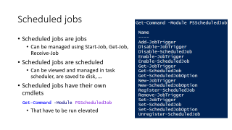
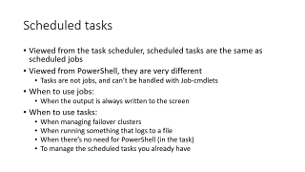
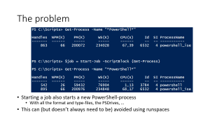
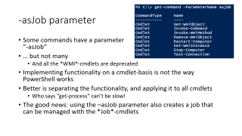




Jobs and scheduling

Slide 3
Overview
Jobs:
PS is single threaded, so if you let it do something that takes a while, you’ll have to wait
Unless you tell PS to run the task in the background
When it finishes, you can check the results
Runspaces:
A job runs in a separate process, not a separate thread
The distinction is academical when starting 2 jobs, but not when starting 200
Scheduling:
When you want something to be done on a certain point in the future
Two options: schedule it as a job, or as a task
Notes:
https://docs.microsoft.com/en-us/powershell/module/microsoft.powershell.core/about/about_jobs?view=powershell-6
https://blogs.technet.microsoft.com/heyscriptingguy/2015/11/26/beginning-use-of-powershell-runspaces-part-1/
https://blogs.technet.microsoft.com/heyscriptingguy/2013/11/23/using-scheduled-tasks-and-scheduled-jobs-in-powershell/

Slide 4
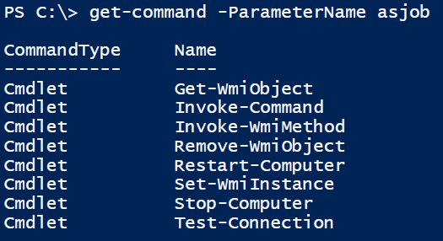
-asJob parameter
Some commands have a parameter “-asJob”
… but not many
And all the *WMI*-cmdlets are deprecated
Implementing functionality on a cmdlet-basis is not the way PowerShell works
Better is separating the functionality, and applying it to all cmdlets
Who says “get-process” can’t be slow!
The good news: using the –asJob parameter also creates a job that can be managed with the *Job*-cmdlets

Slide 5

Why?
Get-Date -Format "HH:mm:ss,fff"
$folder = "c:\tmp\Logs";
$logs = "system","application"
foreach ($log in $logs)
{
$filename = "$env:computername".ToUpper() + `
"-$log-log-" + (Get-Date -Format yyyyMMdd) + ".log"
Get-EventLog $log | out-file $folder\$filename
}
Get-Date -Format "HH:mm:ss,fff"

Slide 6
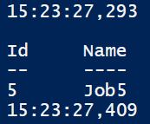
Solution!
The same code, but as a job…
Runs a lot faster
Results?
Get-Date -Format "HH:mm:ss,fff"
Start-Job -ScriptBlock {
# the same code
}
Get-Date -Format "HH:mm:ss,fff"
Notes:
Get-Date -Format "HH:mm:ss,fff"
Start-Job -ScriptBlock {
$folder = "c:\tmp\Logs";
$logs = "system","application"
foreach ($log in $logs)
{
$filename = "$env:computername".ToUpper() + `
"-$log-log-" + (Get-Date -Format yyyyMMdd) + ".log"
Get-EventLog $log | out-file $folder\$filename
}
}
Get-Date -Format "HH:mm:ss,fff"

Slide 7
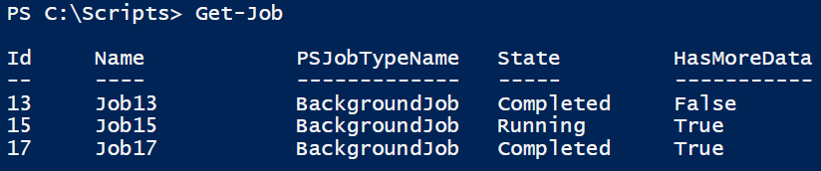
Getting jobs
“Get-Job” shows all jobs that haven’t been removed
You could name jobs (when creating them)
Remove-Job will only remove jobs that have been finished, but will also remove all (unread) data
When using –Force, running jobs can also be removed

Slide 8
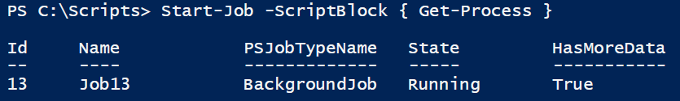
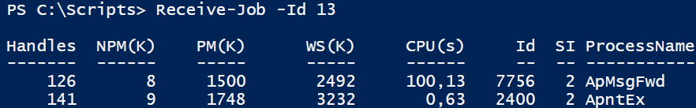
Receive-Job
Get the results of a job
Only shows the results that go to the console

Slide 9
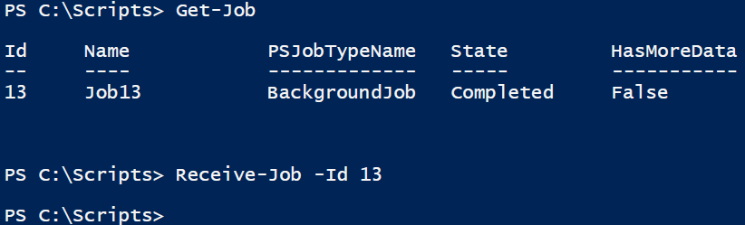
Receive-Job
Once the results have been ‘read’, they’re gone
So, don’t read the output to soon, or you’ll end up with half the information twice
Alternative: use the parameter “-Keep”

Slide 10
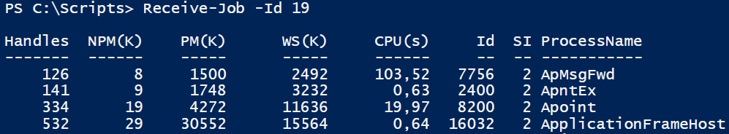
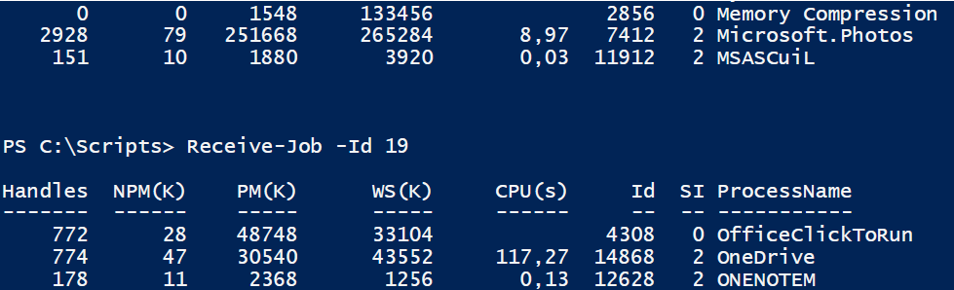
Receive-job without keep on a running job
…

Slide 11
Wait for a job
Suppose you want to receive the results of a job, but only the complete results
Which means waiting for the job to finish
But you want to issue the command before the job has finished!
The result is kind of the same as simply running “Get-Process”
Start-Job -ScriptBlock { Get-Process } | Receive-Job -Wait

Slide 12
Wait for a job
Or use Wait-Job
Wait-Job waits until all jobs in the list have finished
You could wait for one job, or for all jobs
If you don’t want to wait to long, specify a timeout (in seconds)
Wait-Job -Id 21
Wait-Job -Id 21 -Timeout 120

Slide 13
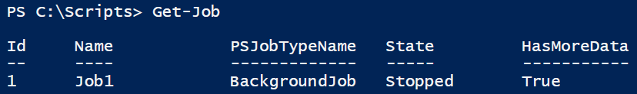
Stopping a job
If a job lasted long enough, you can stop it
This shows up in Get-Job…
The data that had been gathered remains available
$job = Start-Job -ScriptBlock { Get-Process }
$job | Stop-Job

Slide 14
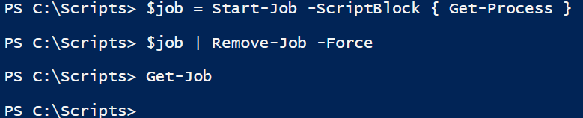
Deleting a job
When you want to clear out the Get-Job list, use Remove-Job
Remove-Job let running jobs be, unless you force it
Removing a job also clears the results

Slide 15
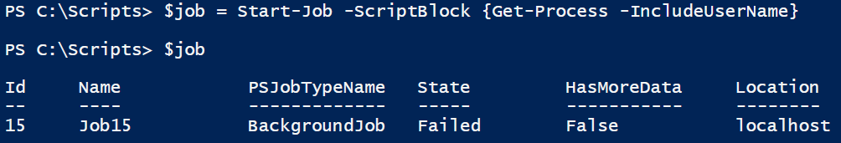
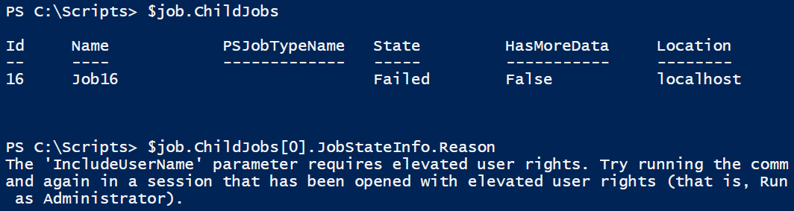
Investigating a failed job
Some jobs fail…
Find out why by looking into the childjobs…

Slide 16
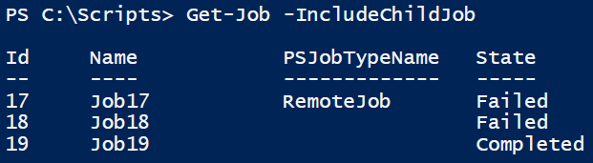
Job Details
Why is there a child-job? Why not just one job
Also, why are all jobs numbered odd?
Because when running a job, it creates a child-job for every computer we run it on
We started all our jobs on one computer, so had one childjob per job
Why did it fail?
Invoke-Command -ScriptBlock { Get-Process } `
-ComputerName localhost, "192.168.255.42" `
-AsJob
(Get-Job -id 18).JobStateInfo.Reason

Slide 17
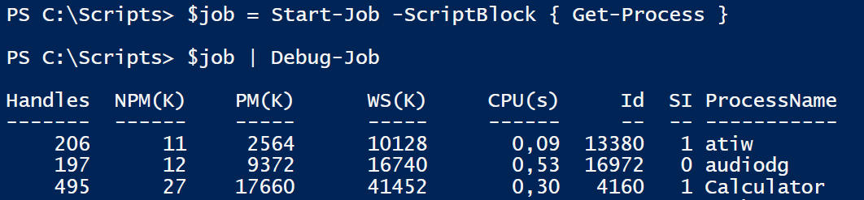
Debug-Job
(New since PS v5.0)
Enters a running background job, and lets it run in the foreground
$job = Start-Job -ScriptBlock { Get-Process }
$job | Debug-Job

Slide 18
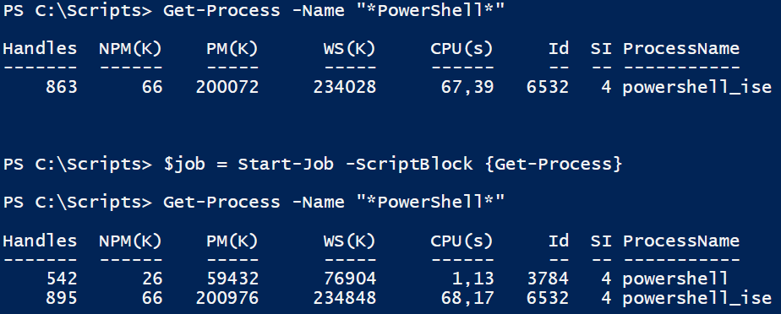
The problem
Starting a job also starts a new PowerShell-process
With all the format and type-files, the PSDrives, …
This can (but doesn’t always need to be) avoided using runspaces

Slide 19
The new problem
Runspaces are way more difficult than jobs…
Step 1: create PowerShell-object that houses a script that takes 5 seconds:
Run: takes 5 seconds
$PowerShell = [PowerShell]::Create()
[void]$PowerShell.AddScript({
Get-Date
Start-Sleep 5
})
$PowerShell.Invoke()

Slide 20
The solution
Step 2: create a runspace, add the PS-object to that runspace, an run it
Still takes 5 seconds…
$Runspace = [runspacefactory]::CreateRunspace()
$PowerShell = [PowerShell]::Create()
$PowerShell.runspace = $Runspace
$Runspace.Open()
[void]$PowerShell.AddScript({
Get-Date
Start-Sleep 5
})
$PowerShell.Invoke()

Slide 21
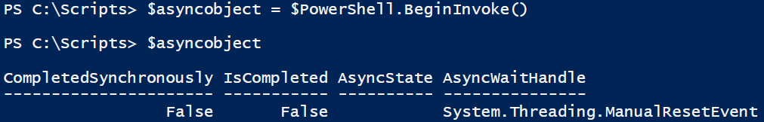
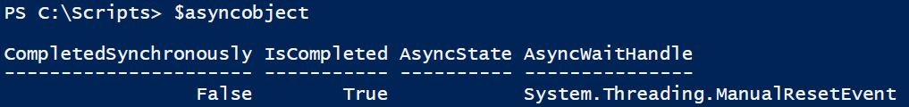
The solution
Step 3: Use “BeginInvoke()” in stead of “Invoke()”
And check up on the object…

Slide 22
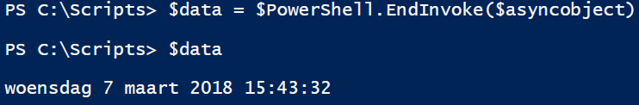
The results
Getting the results is again slightly more work…
Don’t forget to clean up the mess we made
You could use the posh module
https://blogs.technet.microsoft.com/heyscriptingguy/2015/11/29/weekend-scripter-a-look-at-the-poshrsjob-module/
$PowerShell.Dispose()
Notes:
Read more: https://blogs.technet.microsoft.com/heyscriptingguy/2015/11/26/beginning-use-of-powershell-runspaces-part-1/

Slide 23
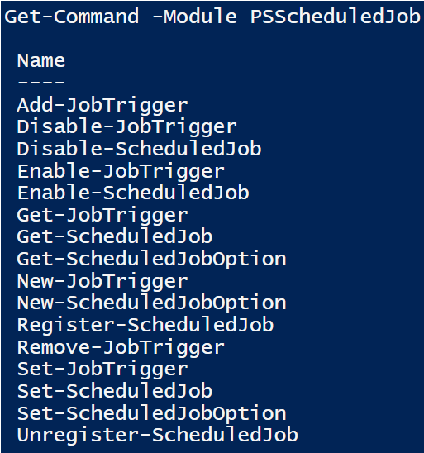
Scheduled jobs
Scheduled jobs are jobs
Can be managed using Start-Job, Get-Job, Receive-Job
Scheduled jobs are scheduled
Can be viewed and managed in task scheduler, are saved to disk, …
Scheduled jobs have their own cmdlets
That have to be run elevated
Get-Command -Module PSScheduledJob
Notes:
https://blogs.technet.microsoft.com/heyscriptingguy/2014/05/12/introduction-to-powershell-scheduled-jobs/
https://docs.microsoft.com/en-us/powershell/module/psscheduledjob/about/about_scheduled_jobs?view=powershell-5.1
Like Windows PowerShell background jobs, scheduled jobs run asynchronously in the background. Instances of scheduled jobs that have run can be managed by using the job cmdlets, such as Start-Job, Get-Job, Stop-Job, and Receive-Job.
Like Task Scheduler tasks, scheduled jobs are saved to disk. You can view and manage the jobs in Task Scheduler, enable and disable them as needed, run them or use them as templates, establish a one-time or recurring schedules for starting the jobs, or set conditions under which the jobs start.
In addition, the results of scheduled job instances are saved to disk in an easily accessible format, providing a running log of job output. Scheduled jobs come with a customized set of cmdlets for managing them. The cmdlets let you create, edit, manage, disable, and re-enable scheduled jobs, job triggers and job options.

Slide 24
Job triggers
Create a new trigger: New-JT (New-JobTrigger)
Add trigger to a job: Add-JT
Enable/Disable the trigger temporarily: Enable-JT, Disable-JT
Delete the trigger: Remove-JT
Name and ID parameter: of scheduled job, not of job trigger
Examples:
$time = (Get-Date -Hour 17 -Minute 15)
New-JobTrigger -Daily -At $time -DaysInterval 3
New-JobTrigger -Weekly -DaysOfWeek Monday, Wednesday, Friday -At "23:00"
New-JobTrigger -AtLogOn -User Domain01\Admin01 -RandomDelay 00:20:00
Notes:
New-JobTrigger: Creates a job trigger.
Get-JobTrigger: Gets a job trigger.
Add-JobTrigger: Adds a job trigger to a scheduled job.
Set-JobTrigger: Changes a job trigger.
Disable-JobTrigger: Temporarily disables a job trigger.
Enable-JobTrigger: Re-enables a job trigger.
Remove-JobTrigger: Deletes a job trigger.

Slide 25
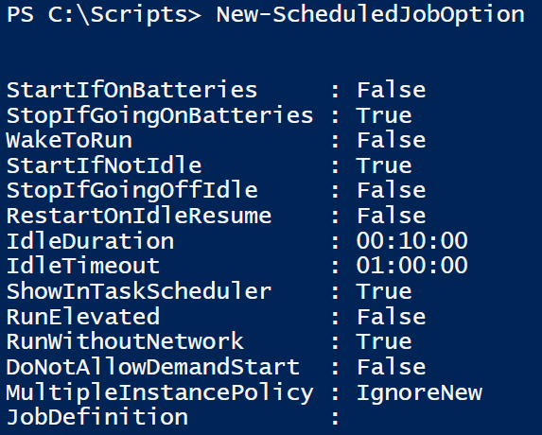
Scheduled job options
Scheduled jobs have some advanced parameters that can’t be set using the cmdlets to create the job
They can be initiated by using scheduled job options
New-, Get- and Set-ScheduledJobOption
Simply running New-SJO returns all the default values:
Notes:
New-ScheduledJobOption: Creates a job options object.
Get-ScheduledJobOption: Gets the job options of a scheduled job.
Set-ScheduledJobOption: Changes the job options of a scheduled job.

Slide 26
Scheduled job
First: create trigger and job options, and store both in a variable
Then:
Create a job: Register-SJ (Register-ScheduledJob)
Change: Set-SJ
Look at all existing: Get-SJ
Or via the task scheduler
Temporarily disable/enable the job: Enable-SJ, Disable-SJ
Delete the job and all saved results: Unregisted-SJ
Notes:
Register-ScheduledJob: Creates a scheduled job.
Get-ScheduledJob: Gets a scheduled job.
Set-ScheduledJob: Changes the properties of a scheduled job
Disable-ScheduledJob: Temporarily disables a scheduled job.
Enable-ScheduledJob: Re-enables a scheduled job.
Unregister-ScheduledJob Deletes a scheduled job and its saved results.

Slide 27
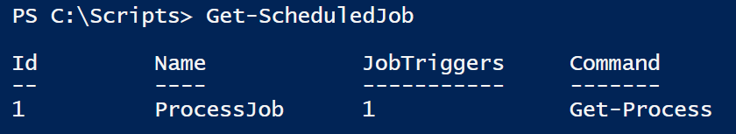
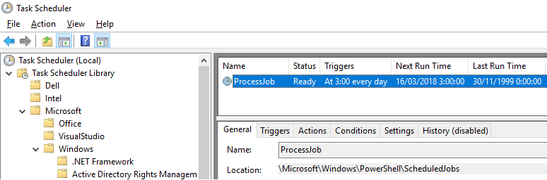
Example
$trigger = New-JobTrigger -Daily -At 3AM
$options = New-ScheduledJobOption -StartIfOnBattery
Register-ScheduledJob -Name ProcessJob -ScriptBlock {Get-Process} `
-Trigger $trigger -ScheduledJobOption $options
Results:

Slide 28



Example
Changing a trigger:
Disable a job:
Remove a job:
Get-ScheduledJob -Id 1 | Get-JobTrigger | Set-JobTrigger -At "15:00"
Get-ScheduledJob -Id 1 | Disable-ScheduledJob
Get-ScheduledJob -Id 1 | Unregister-ScheduledJob

Slide 29
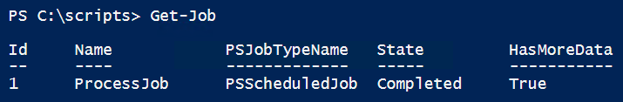
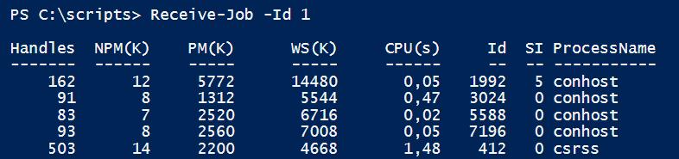
A scheduled job is a job
$trigger = New-JobTrigger -Once -At (Get-Date).AddMinutes(2)
Register-ScheduledJob -Name ProcessJob -ScriptBlock {Get-Process} `
-Trigger $trigger
After running…

Slide 30
A scheduled job is a job
After running again (twice)

Slide 31
Scheduled tasks
Viewed from the task scheduler, scheduled tasks are the same as scheduled jobs
Viewed from PowerShell, they are very different
Tasks are not jobs, and can’t be handled with Job-cmdlets
When to use jobs:
When the output is always written to the screen
When to use tasks:
When managing failover clusters
When running something that logs to a file
When there’s no need for PowerShell (in the task)
To manage the scheduled tasks you already have
Notes:
https://blogs.technet.microsoft.com/heyscriptingguy/2013/11/23/using-scheduled-tasks-and-scheduled-jobs-in-powershell/

Slide 32
Scheduled tasks
Get-Command -Module ScheduledTasks
Create the action: New-STAction (New-ScheduledTaskAction)
Create the trigger: New-STTrigger
Create the principal: New-STPrincipal
Create additional settings: New-STSettings
Create the new scheduled task: New-ScheduledTask
Using all of the above
Register the new task: Register-ScheduledTask
Using the task you just created

Slide 33
Example
$A = New-ScheduledTaskAction -Execute "ZoomIt.exe"
$T = New-ScheduledTaskTrigger -AtLogon
$P = New-ScheduledTaskPrincipal $env:USERNAME
$S = New-ScheduledTaskSettingsSet
$D = New-ScheduledTask -Action $A -Principal $P -Trigger $T -Settings $S
Register-ScheduledTask ZoomIt -InputObject $D
And the result…

